Slide 1
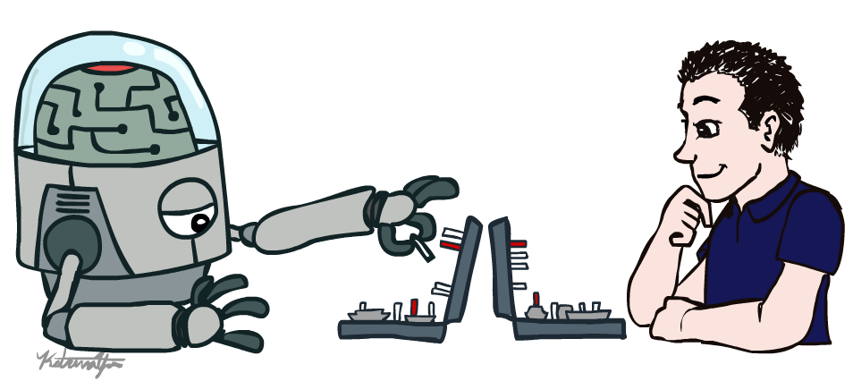
Artificial Intelligence
Introduction
(slides adapted from Anca Dragan)
Slides by Dan Klein, Pieter Abbeel, Anca Dragan (ai.berkeley.edu)

Slide 2
Robots look like this. We have autonomous cars that figure out how to take us to our destination
Notes:
Robots look like this. We have autonomous cars that figure out how to take us to our destination

Slide 3
Robots help nurses in hospitals deliver stuff to different rooms
Notes:
Robots help nurses in hospitals deliver stuff to different rooms

Slide 4
Drones that record cool videos of us as we do outdoor activities
Notes:
Or drones that record cool videos of us as we do outdoor activities
Or in my case,

Slide 5
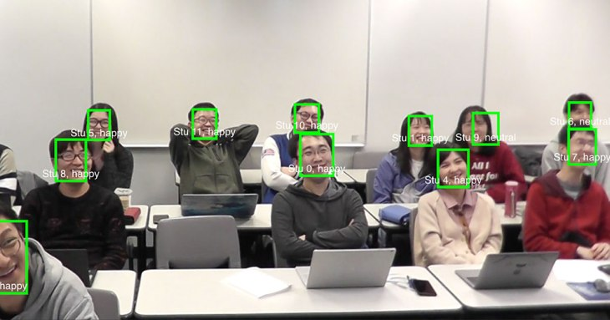
The state of the art of AI
Link

Slide 6
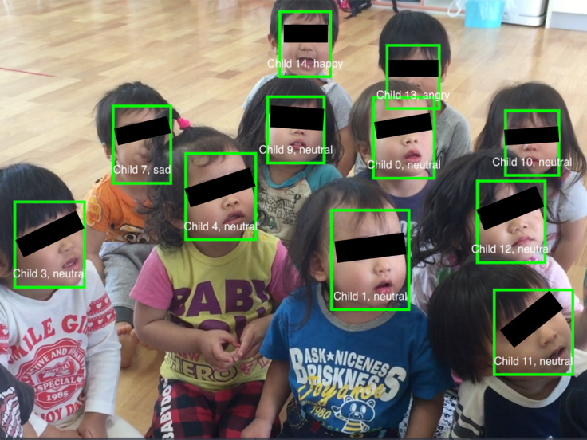

Slide 7
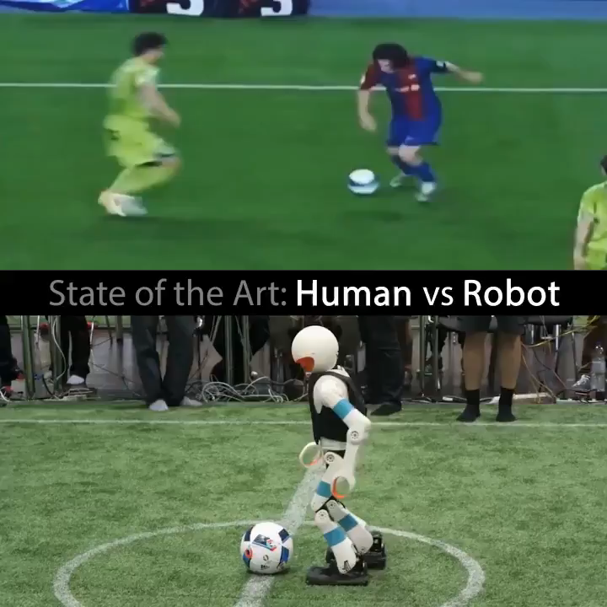
A reminder for engineers trying to build AI systems that achieve human-level performance. It's often a lot harder than we at first realize. Humans are amazing.

Slide 8
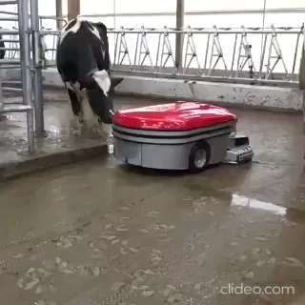

Slide 9
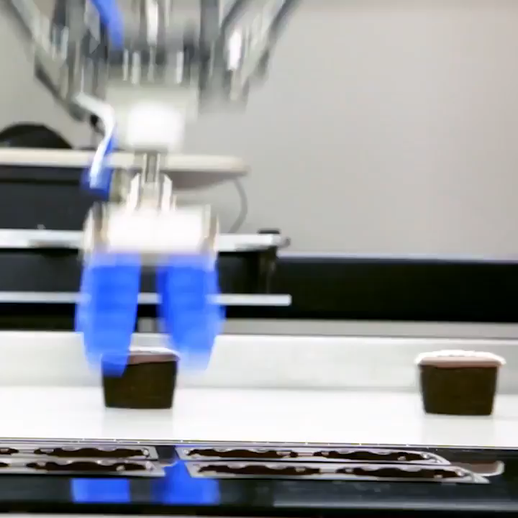

Slide 10
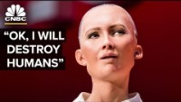
Sofia

Slide 11
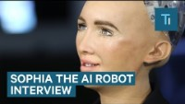
Sofia & “indeed” default answer

Slide 12
Deadly orders and rules that Blinly applied
Rules: The mom said “if you keep doing this crap, I will tell Blinky to cook you for diner”
Orders: Alex, “kill me, kill my parents, kill everybody ……”

Slide 13
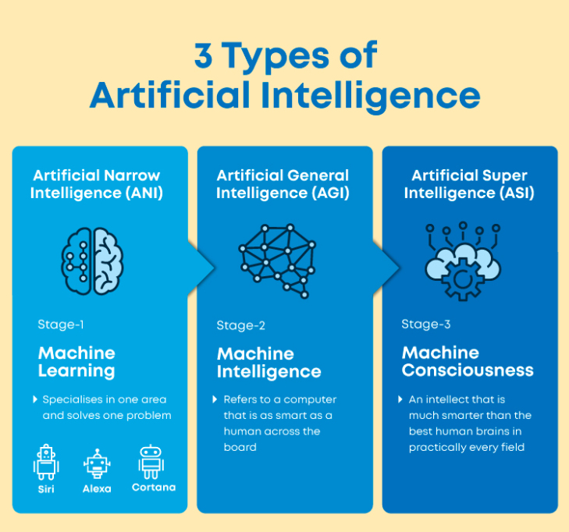
Types of AI

Slide 14


Slide 15
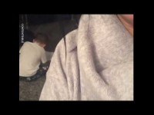
Alexa helps to solve assignments ☺

Slide 16
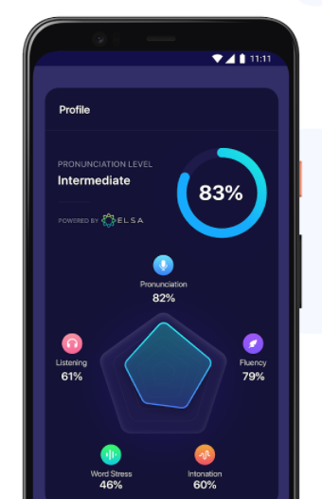
AI powered Apps (Elsa App)

Slide 17
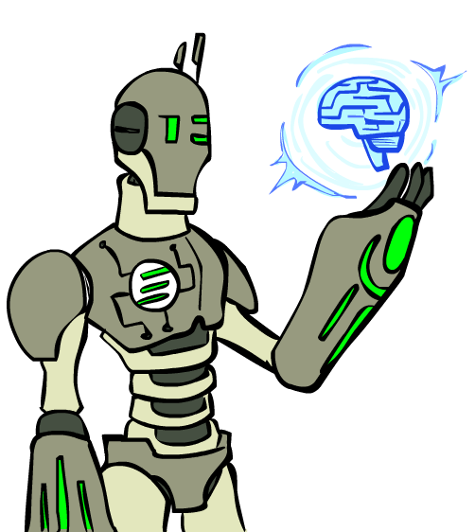
Today
What is artificial intelligence?
Where did it come from/What can AI do?
What should we and shouldn’t we worry about? What can we do about the things we should worry about?
What is this course?

Slide 18
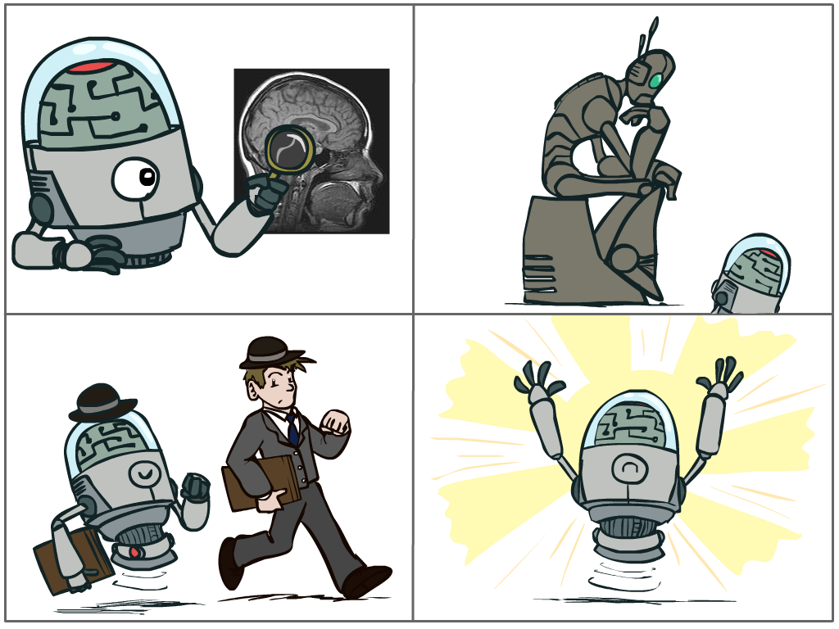
What is AI?
The science of making machines that:
Think like people
Think rationally
Act like people
Act rationally
Notes:
Top left: natural intelligence -- Think like people --- cognitive science, neuroscience
Bottom left: who cares about how they think? act like people --- actually very early definition, dating back to Alan Turing --- Turing test; problem to do really well you start focusing on things like don’t answer too quickly what the square root of 1412 is, don’t spell too well, and make sure you have a favorite movie etc. So it wasn’t really leading us to build intelligence
Think rationally – correct thought process -- long tradition dating back to Aristotle --- this is how to think so that you don’t make mistakes; but not a winner, because difficult to encode how to think / especially in the face of unknowns/uncertainty, and in the end it’s not about how you think, it’s about how you end up acting

Slide 19
Rational Decisions
We’ll use the term rational in a very specific, technical way:
Rational: maximally achieving pre-defined goals
Rationality only concerns what decisions are made
(not the thought process behind them)
Goals are expressed in terms of the utility of outcomes
Being rational means maximizing your expected utility
A better title for this course would be:
Computational Rationality
Notes:
Not about building machines that don’t get angry
Example of utilities. 10 for A, 1 for each Friday with friends

Slide 20
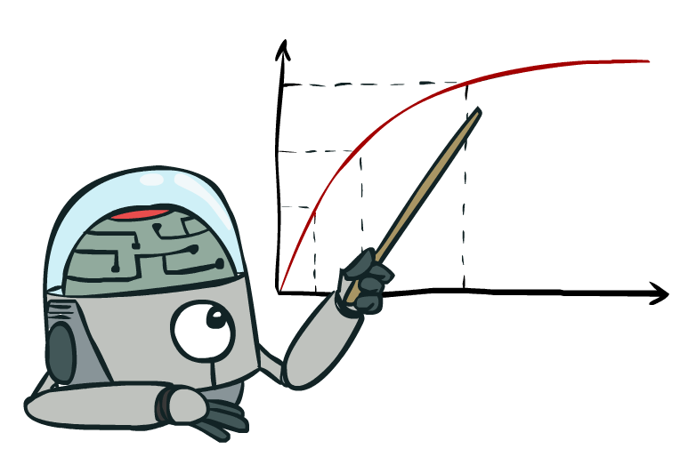
Maximize Your
Expected Utility
Notes:
Distill course to maximize expected utility

Slide 21
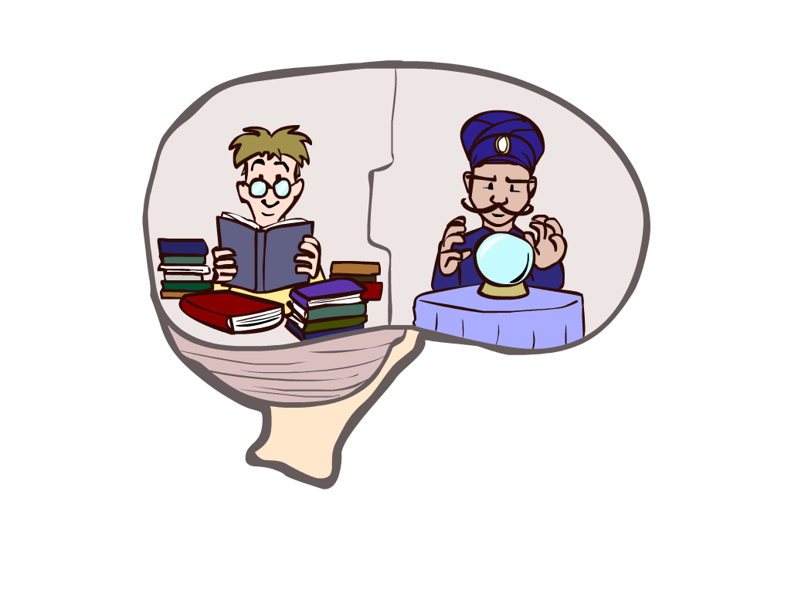
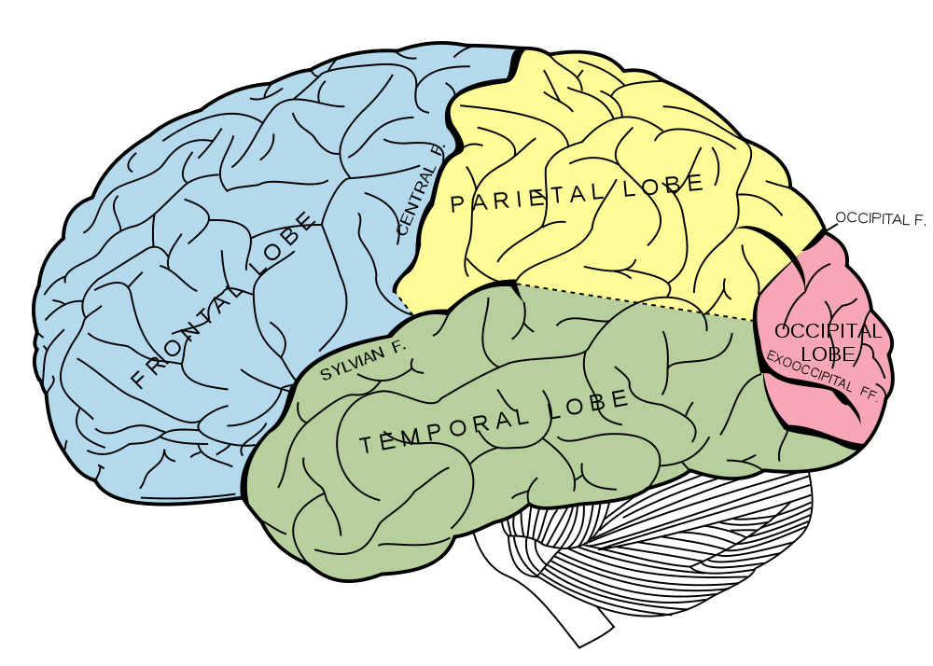
What About the Brain?
Brains (human minds) are very good at making rational decisions, but not perfect
Brains aren’t as modular as software, so hard to reverse engineer!
“Brains are to intelligence as wings are to flight”
Lessons learned from the brain: memory and simulation are key to decision making
Notes:
Stopped making wings that flap

Slide 22
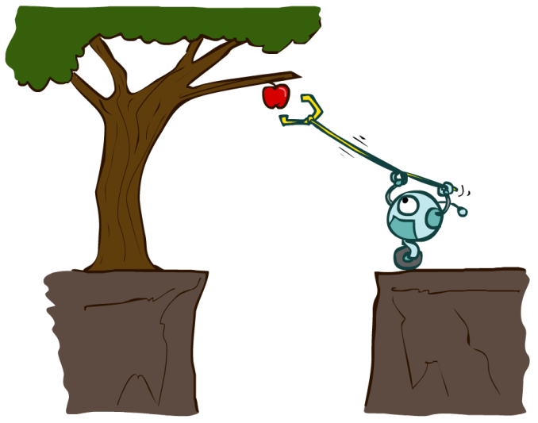
Designing Rational Agents
An agent is an entity that perceives and acts.
A rational agent selects actions that maximize its (expected) utility.
Characteristics of the percepts, environment, and action space dictate techniques for selecting rational actions
Sensors
Agent
Percepts
Environment
?
Actuators
Actions

Slide 23
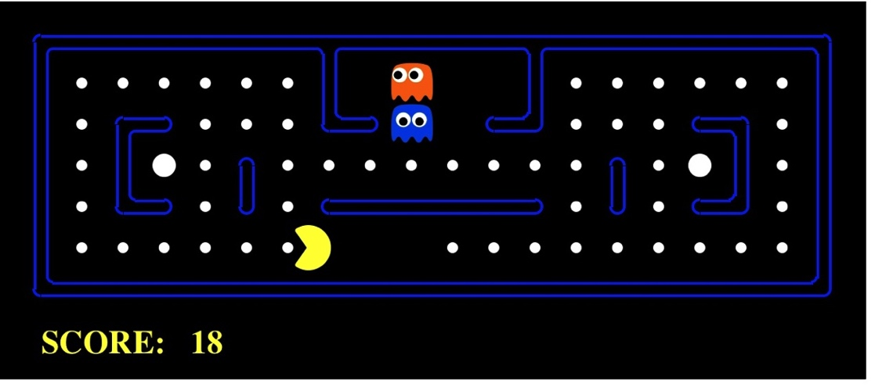
Pac-Man as an Agent
Agent
Environment
Sensors
Percepts
?
Actuators
Actions
Pac-Man is a registered trademark of Namco-Bandai Games, used here for educational purposes
Demo1: pacman-l1.mp4

Slide 24
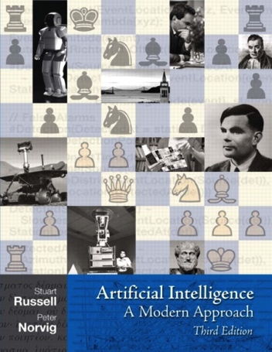
Textbook
Russell & Norvig, AI: A Modern Approach

Slide 25
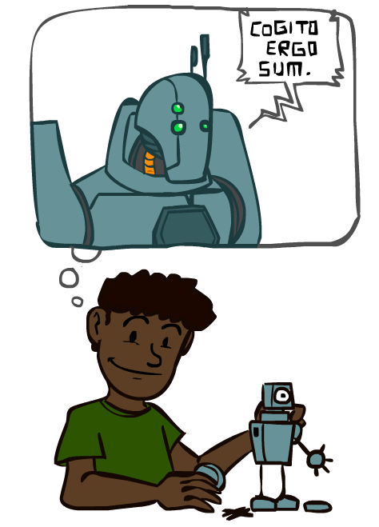
A (Short) History of AI

Slide 26
A (Short) History of AI
1940-1950: Early days
1943: McCulloch & Pitts: Boolean circuit model of brain
1950: Turing's “Computing Machinery and Intelligence”
1950—70: Excitement: Look, Ma, no hands!
1950s: Early AI programs, including Samuel's checkers program, Newell & Simon's Logic Theorist, Gelernter's Geometry Engine
1956: Dartmouth meeting: “Artificial Intelligence” adopted
1965: Robinson's complete algorithm for logical reasoning
1970—90: Knowledge-based approaches
1969—79: Early development of knowledge-based systems
1980—88: Expert systems industry booms
1988—93: Expert systems industry busts: “AI Winter”
1990—: Statistical approaches
Resurgence of probability, focus on uncertainty
General increase in technical depth
Agents and learning systems… “AI Spring”?
2000—: Where are we now?
Notes:
Computation with circuits, brain was like a bunch of circuits
Less computation than your watch; could barely do anything , but we thought we’re right there
Write stuff down, they start contradicting; winter
Statistics, uncertainty
Computation with artificial neurons, brain was like a bunch of real neurons ☺

Slide 27
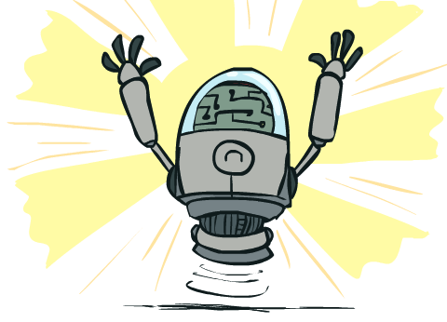
What Can AI Do?
Quiz: Which of the following can be done at present?
Play a decent game of Jeopardy?
Win against any human at chess?
Win against the best humans at Go?
Play a decent game of tennis?
Grab a particular cup and put it on a shelf?
Unload any dishwasher in any home?
Drive safely along the highway?
Drive safely along Telegraph Avenue?
Buy a week's worth of groceries on the web?
Buy a week's worth of groceries at Berkeley Bowl?
Discover and prove a new mathematical theorem?
Perform a surgical operation?
Unload a know dishwasher in collaboration with a person?
Translate spoken Chinese into spoken English in real time?
Write story?
Write an intentionally funny story?

Slide 28
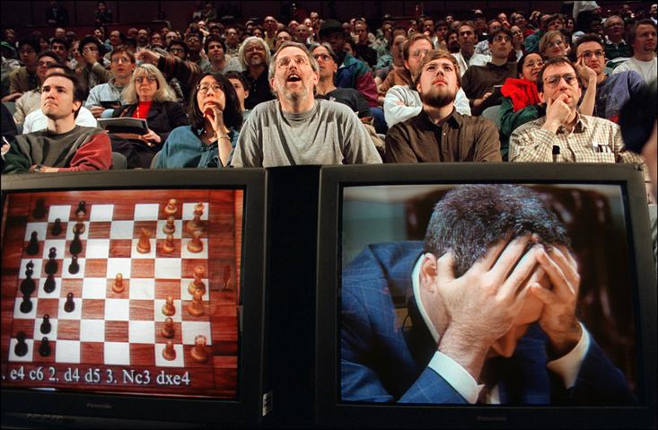

Slide 29
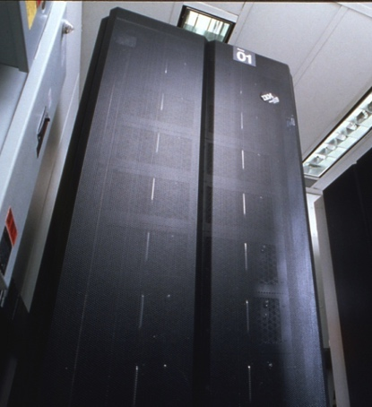
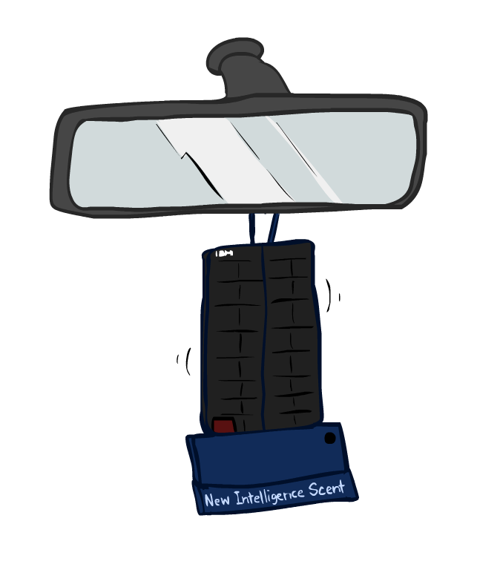
Game Agents
Classic Moment: May, '97: Deep Blue vs. Kasparov
First match won against world champion
“Intelligent creative” play
200 million board positions per second
Humans understood 99.9 of Deep Blue's moves
Can do about the same now with a PC cluster
1996: Kasparov Beats Deep Blue
“I could feel --- I could smell --- a new kind of intelligence across the table.”
1997: Deep Blue Beats Kasparov
“Deep Blue hasn't proven anything.”
Text from Bart Selman, image from IBM’s Deep Blue pages
Notes:
Yeah, Kasparov comment probably says more about humans than about computers

Slide 30

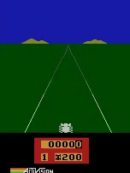
Game Agents
Reinforcement learning
Pong
Enduro

Slide 31
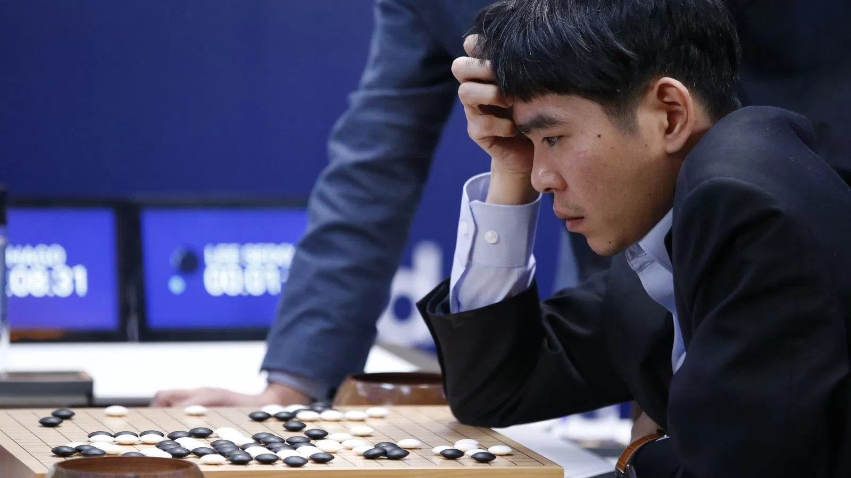
Game Agents
Reinforcement learning

Slide 32
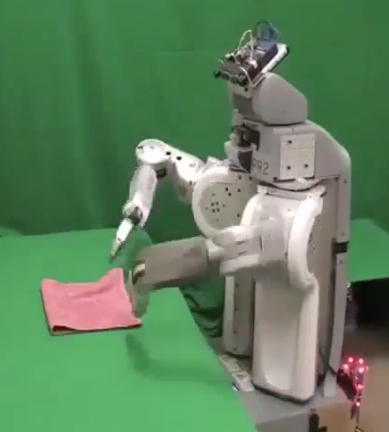
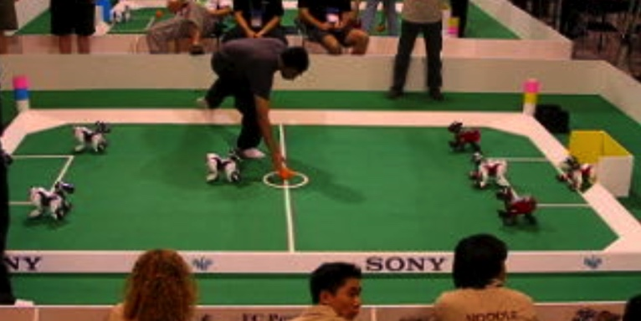
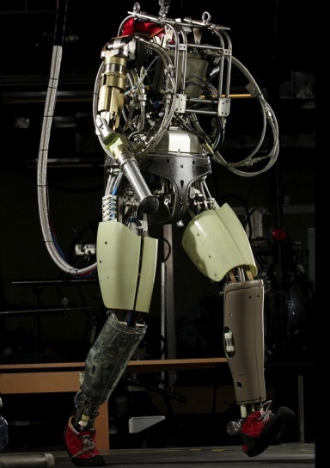
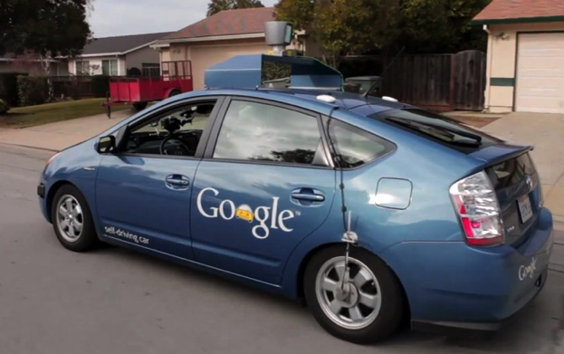
Robotics
Demo 1: ROBOTICS – soccer.avi
Demo 4: ROBOTICS – laundry.avi
Demo 2: ROBOTICS – soccer2.avi
Demo 5: ROBOTICS – petman.avi
Demo 3: ROBOTICS – gcar.avi
Robotics
Part mech. eng.
Part AI
Reality much
harder than
simulations!
Technologies
Vehicles
Rescue
Help in the home
Lots of automation…
In this class:
We ignore mechanical aspects
Methods for planning
Methods for control
Images from UC Berkeley, Boston Dynamics, RoboCup, Google

Slide 33
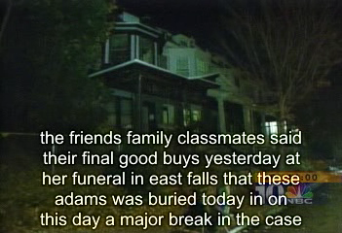
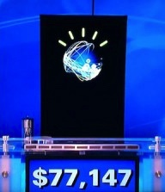
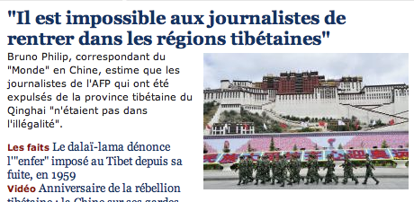
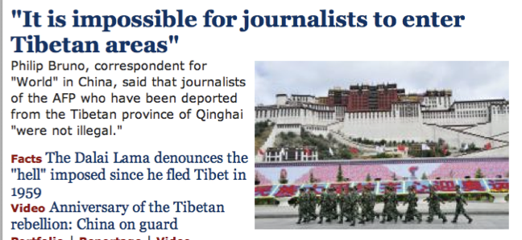
Natural Language
Speech technologies (e.g. Siri)
Automatic speech recognition (ASR)
Text-to-speech synthesis (TTS)
Dialog systems
Language processing technologies
Question answering
Machine translation
Web search
Text classification, spam filtering, etc…

Slide 34
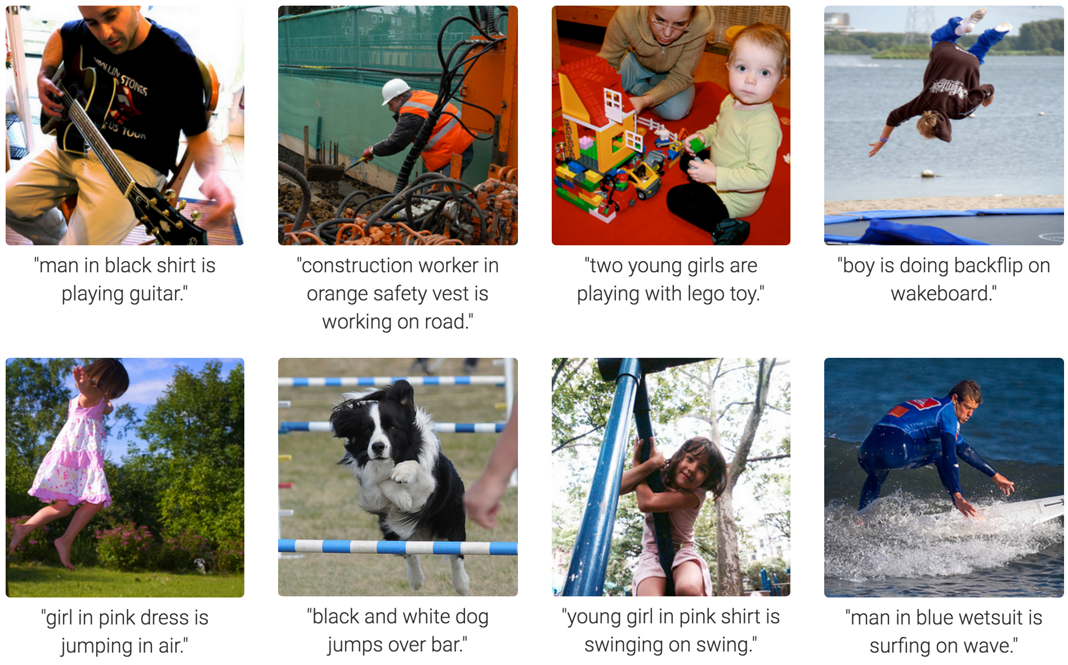
Computer Vision
Karpathy & Fei-Fei, 2015; Donahue et al., 2015; Xu et al, 2015; many more

Slide 35
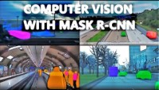

Slide 36
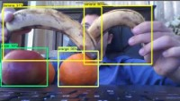

Slide 37
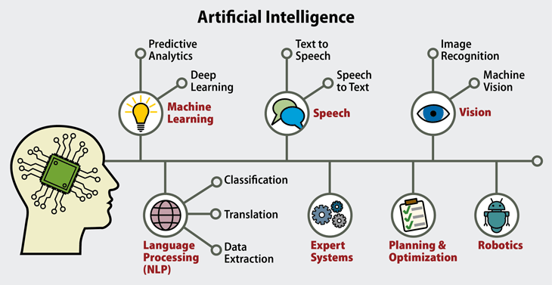

Slide 38
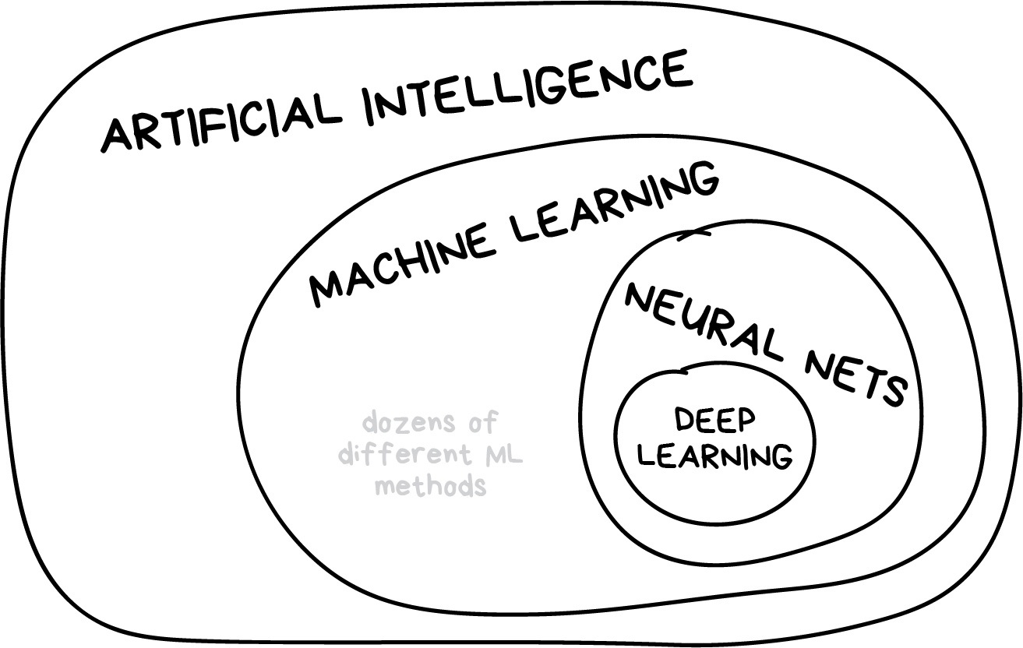

Slide 39


Slide 40
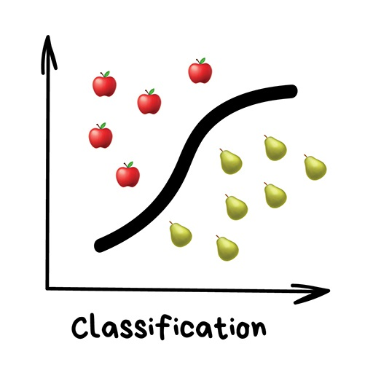

Slide 41
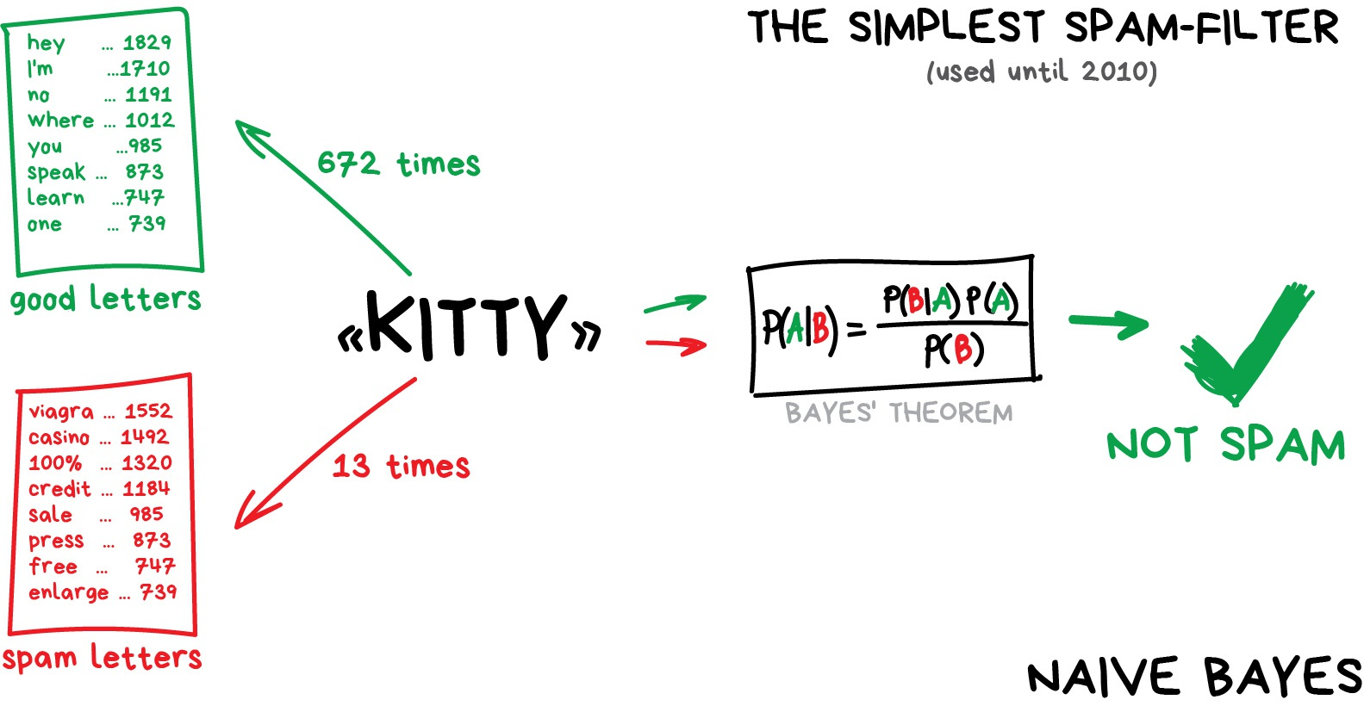

Slide 42
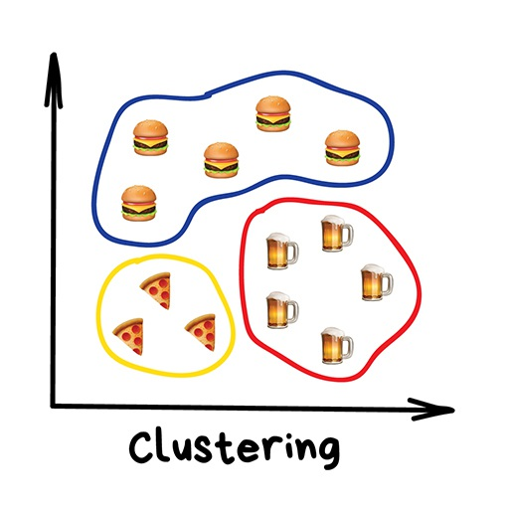

Slide 43


☺

